Slide 1
Make IT Short
21102042 Seungwoo Baik
21102033 Daehun Kwon
21102054 Saeyeon Lim

Slide 2
contents
1. Task Introduction
2. Modified Code
3. Byte count & Compiling
4. Execution
5. Comparing To Origin
21/35p

Slide 3
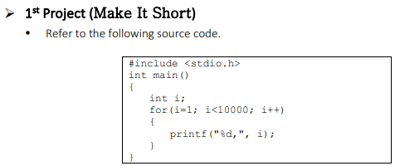


Task Introduction
21/35p

Slide 4
Task Introduction(origin code)
1 #include <stdio.h>
2 int main()
3 {
4 int i;
5 for (i=1; i<10000; i++)
6 {
7 printf(“%d,”, i);
8 }
9 }
Running this code will output from 1 to 9999 as a result.
We should minimize the character count of the code. Also, the result should be same with this.
Our code should not include any while or for loops.
21/35p

Slide 5
Task Introduction(origin code)
1 #include <stdio.h>
2 int main()
3 {
4 int i;
5 for (i=1; i<10000; i++)
6 {
7 printf(“%d,”, i);
8 }
9 }
In certain specialized situations, it’s possible to use the ‘printf’ function without including the <stdio.h> header file.
In C90, if the return type of a function is not explicitly specified, it is implicitly assumed to be of type ‘int’.
We can use a recursion instead of for loop.
21/35p

Slide 6

Modified Code
1. main(i): The function takes an integer i as its parameter. Note that return type is omitted, and it implicitly returns an int.
2. printf(“%d,”,i++): The function prints the current value of i followed by a comma.
main(i){printf(“%d,”, i++);i<1e4&&main(i);}
3. i<1e4&&main(i): This is a compact recursive call. It uses the short-circuiting behavior of the && operator.
21/35p

Slide 7
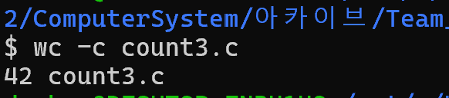
Byte counting & Compiling
Results:
The file size check showed that it is 42 bytes.
Additionally, the file count3.c was compiled into an executable named count3 using GCC.
21/35p

Slide 8

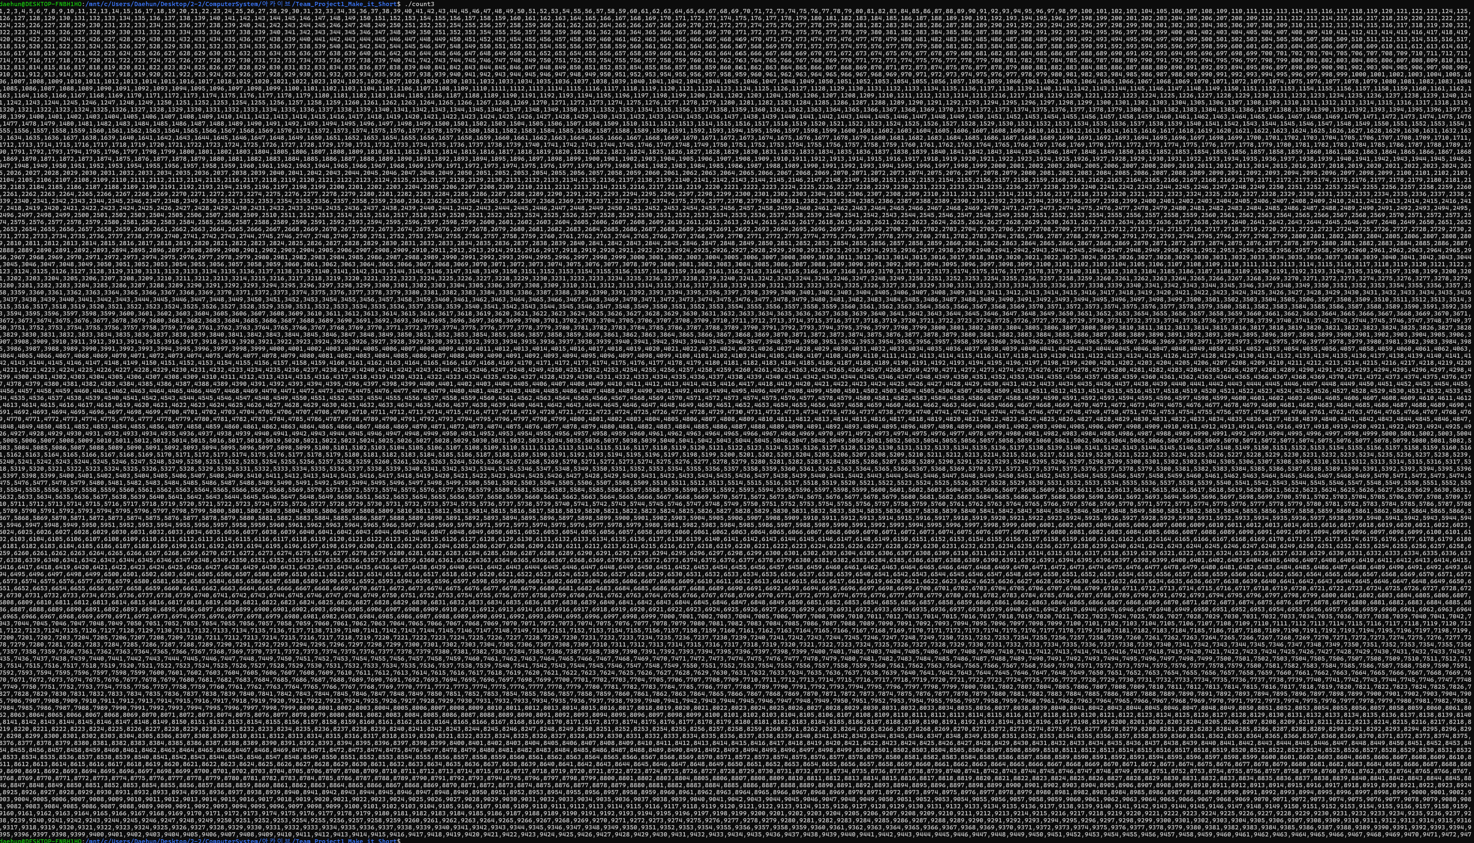
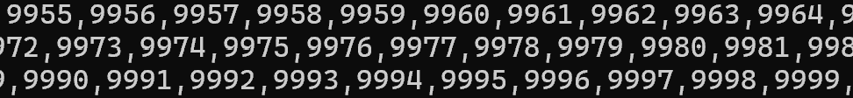
Execution
21/35p

Slide 9

Comparing To Origin
Results:
Comparing the compiled files count(origin code) and count3(modified code) showed no differences in the output. This indicates that both files produce identical results.
21/35p

Slide 10
Thank You

